Slide 1

Evidence to action: Doing research together
Supporting inclusive and collaborative research partnerships
13 October 2025
Notes:
Slide 1
Title: Evidence to action: Doing research together
Supporting inclusive and collaborative research partnerships
13 October 2025
The lower right-hand side of the slide includes the NDRP logo and the lower half of the slide includes a multi coloured NDRP brand with sweeping lines.

Slide 2
Acknowledgement of Country
The NDRP acknowledges the traditional custodians of Country throughout Australia. The peoples on whose land we live and work, have lived on and cared for Country for thousands of generations, and this land has never been ceded. We pay our respects to them and their cultures, and to Elders past and present.
Notes:
Slide 2
Title: Acknowledgement of Country
The NDRP acknowledges the traditional custodians of Country throughout Australia. The peoples on whose land we live and work, have lived on and cared for Country for thousands of generations, and this land has never been ceded. We pay our respects to them and their cultures, and to Elders past and present.

Slide 3
Agenda
Welcome and framing
Launch of the DANA Report
Advocacy 101: Who’s who and what they do
Break 10 mins
Building respectful partnerships
Resourcing partnerships fairly
Break 10 mins
Lessons from practice
Closing and next steps
Notes:
Slide 3
Title: Agenda
Welcome and framing
Launch of the DANA Report
Advocacy 101: Who’s who and what they do
Break 10 mins
Building respectful partnerships
Resourcing partnerships fairly
Break 10 mins
Lessons from practice
Closing and next steps

Slide 4
Framing
What works | What gets in the way | What we’re learning
Start together, not just end together | Fast-moving policy cycles vs. slow research timelines | Real partnership is a way of working, not a one-time meeting
Shared purpose and strong relationships | Rigid systems | Mobilising evidence means shaping research together
Clarity, accessibility, and timing | Tokenism and missed follow-through | Advice for researchers: work with policy, not just about it
Disability-led design | Invisible or excluded voices | Advice for policymakers is listen to different kinds of knowledge
 | Barriers to access and understanding | Change is possible when we bridge lived experience and system design
Notes:
Slide 4
Title: Framing
Table with three columns
What works
Start together, not just end together
Shared purpose and strong relationships
Clarity, accessibility, and timing
Disability-led design
What gets in the way
Fast-moving policy cycles vs. slow research timelines
Rigid systems
Tokenism and missed follow-through
Invisible or excluded voices
Barriers to access and understanding
What we’re learning
Real partnership is a way of working, not a one-time meeting
Mobilising evidence means shaping research together
Advice for researchers: work with policy, not just about it
Advice for policymakers is listen to different kinds of knowledge
Change is possible when we bridge lived experience and system design

Slide 5
Resource pack overview
Who’s who
Tips for first contact
Tools and templates
Access and inclusion budgeting
FAQs — answering common questions
Notes:
Slide 5
Title: Resource pack overview
Who’s who
Tips for first contact
Tools and templates
Access and inclusion budgeting
FAQs — answering common questions

Slide 6

Co-design Partnerships:
A Mutual Exchange
Authors: Dr Cherry Baylosis, Alana Starr, Tori Haar
Notes:
Slide 6
Title: Co-design Partnerships: A Mutual Exchange
Authors: Dr Cherry Baylosis, Alana Starr, Tori Haar
And DANA logo

Slide 7
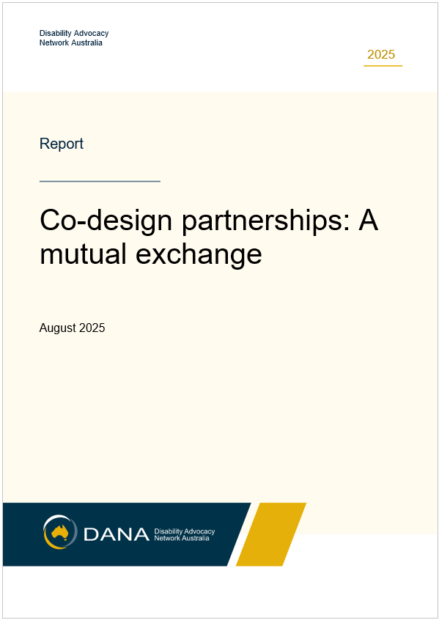
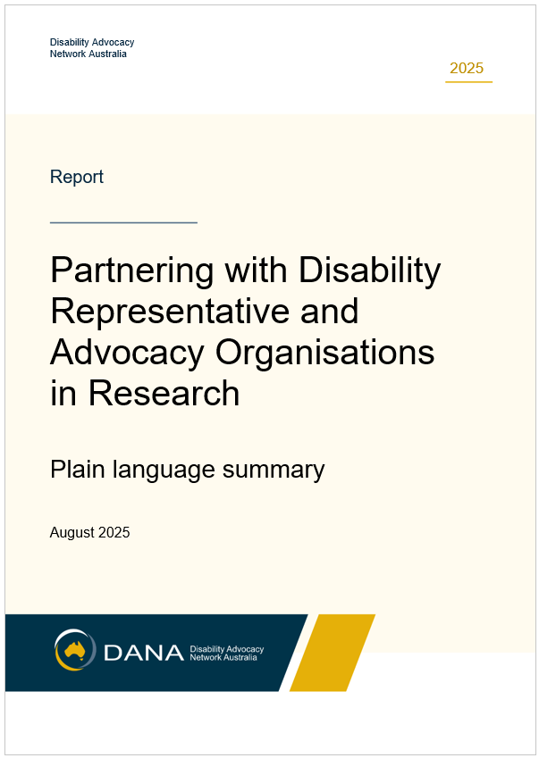
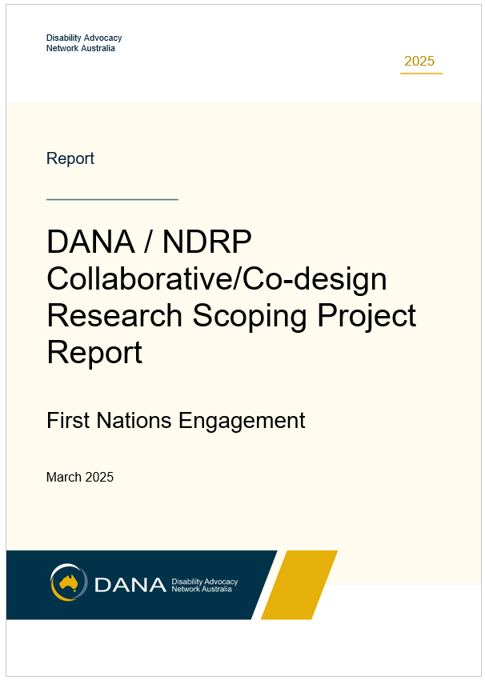
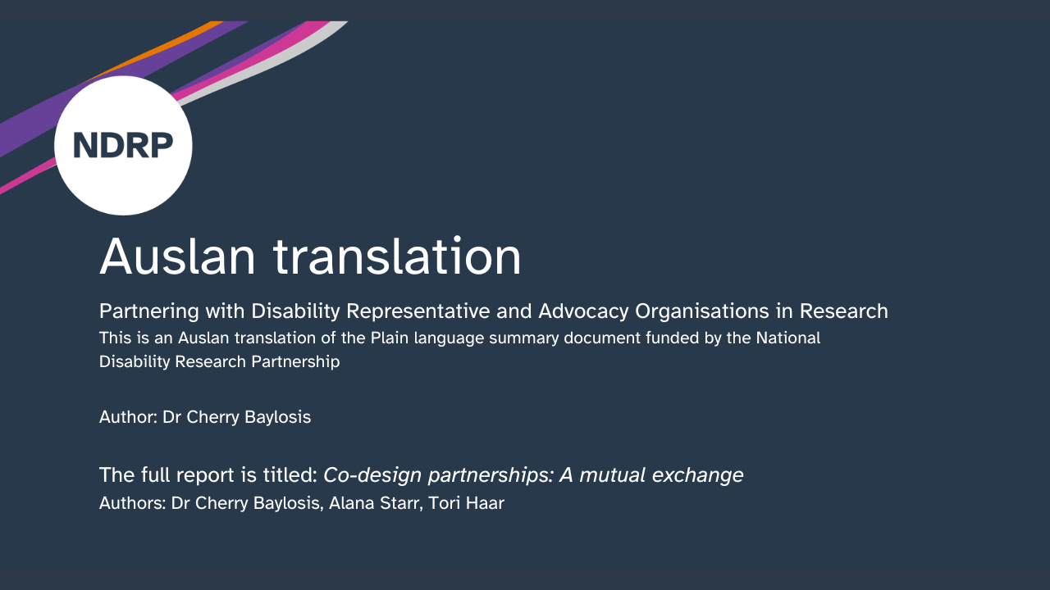
Co-design partnerships: A mutual exchange
Main report
Plain language summary
First Nations engagement report
Auslan translation of Plain language summary
Notes:
Slide 7
Title: Co-design partnerships: A mutual exchange
4 images of the covers of each of the versions of the outputs
Main report
Plain language summary
First Nations engagement report
Auslan translation of Plain language summary

Slide 8
About the project
Purpose: explore what advocacy organisations need to partner meaningfully in research
Conducted by DANA for NDRP
Methods: interviews, surveys, working groups with DRCOs and DAOs
Grounded in mutuality: partnerships that benefit both sides
Notes:
Slide 8
Title: About the project
Purpose: explore what advocacy organisations need to partner meaningfully in research
Conducted by DANA for NDRP
Methods: interviews, surveys, working groups with DRCOs and DAOs
Grounded in mutuality – partnerships that benefit both sides

Slide 9
Key findings
Two-way learning
Researchers must listen through difference, reflect on biases, and use trauma-informed approaches
Partnerships as mutual learning, knowledge flows both ways
Co-define, co-design, co-create
Shared decision-making from start to finish
Co-authoring, co-facilitation, and accessible outputs
Distribution of resources
Partnerships require fair sharing of time, money, and data
Notes:
Slide 9
Title: Key findings
Two-way learning
Researchers must listen through difference, reflect on biases, and use trauma-informed approaches
Partnerships as mutual learning, knowledge flows both ways
Co-define, co-design, co-create
Shared decision-making from start to finish
Co-authoring, co-facilitation, and accessible outputs
Distribution of resources
Partnerships require fair sharing of time, money, and data

Slide 10
Recommendations
Develop guidelines and tools with DRCOs/DAOs (minimum researcher standards, toolkits, resources)
Create structures and templates for shared decision-making and accessible research
Ensure fair resourcing: fund environmental scan, co-design dissemination, publish timeframe guidelines
Notes:
Slide 10
Title: Recommendations
Develop guidelines and tools with DRCOs/DAOs (minimum researcher standards, toolkits, resources)
Create structures and templates for shared decision-making and accessible research
Ensure fair resourcing: fund environmental scan, co-design dissemination, publish timeframe guidelines

Slide 11
Why it matters
True
co-design
Shared power
Fair resources
Mutuality
Elevates lived experience as authoritative knowledge
Builds trust and reciprocity in research partnerships
A roadmap for more inclusive and effective disability research
Notes:
Slide 11
Title: Why it matters
True co-design = mutuality + shared power + fair resources
Elevates lived experience as authoritative knowledge
Builds trust and reciprocity in research partnerships
A roadmap for more inclusive and effective disability research

Slide 12
Evidence to action
Advocacy 101: Who’s who and what they do
Facilitator: Jade McEwan
Notes:
Slide 12
Title: Evidence to action: Advocacy 101: Who’s who and what they do
Facilitator: Jade McEwan
The lower right-hand side of the slide includes the NDRP logo and the lower half of the slide includes a multi coloured NDRP brand with sweeping lines.

Slide 13

Break time
Time for a 10-minute break!
✔ Stretch
✔ Grab a drink
✔ Rest your eyes
We will start again soon.
Notes:
Slide 13
Break time
Time for a 10-minute break!
✔ Stretch
✔ Grab a drink
✔ Rest your eyes
We will start again soon.

Slide 14
Evidence to action
Building respectful partnerships
Facilitator: Linda Steele
Notes:
Slide 14
Title: Evidence to action: Building respectful partnerships
Facilitator: Linda Steele
The lower right-hand side of the slide includes the NDRP logo and the lower half of the slide includes a multi coloured NDRP brand with sweeping lines.

Slide 15
Evidence to action
Resourcing partnerships fairly
Facilitator: Mayer Sayers
Notes:
Slide 15
Title: Evidence to action: Resourcing partnerships fairly
Facilitator: Mayer Sayers
The lower right-hand side of the slide includes the NDRP logo and the lower half of the slide includes a multi coloured NDRP brand with sweeping lines.

Slide 16
Break time
Time for a 10-minute break!
✔ Stretch
✔ Grab a drink
✔ Rest your eyes
We will start again soon.
Notes:
Slide 16
Break time
Time for a 10-minute break!
✔ Stretch
✔ Grab a drink
✔ Rest your eyes
We will start again soon.

Slide 17
Evidence to action
Lessons from practice
Facilitator: Dennis Petrie
Notes:
Slide 17
Title: Evidence to action: Lessons from practice
Facilitator: Dennis Petrie
The lower right-hand side of the slide includes the NDRP logo and the lower half of the slide includes a multi coloured NDRP brand with sweeping lines.

Slide 18




How to engage with the NDRP
Email: info@ndrp.org.au
Phone: 03 9000 3813 SMS only number: 0485 931 168
Subscribe to our newsletter at www.ndrp.org.au for updates
Follow us on Facebook and LinkedIn
Notes:
Slide 18
Title: How to engage with the NDRP
Decorative icons and text reads:
Email: info@ndrp.org.au
Phone: 03 9000 3813
SMS only number: 0485 931 168
Subscribe to our newsletter at www.ndrp.org.au for updates
Follow us on Facebook and LinkedIn
END

